Slide 1
Visually similar pictures recommender
“What if you could choose your next destination based on pictures you like?”
Presented by Kevin THAI

Slide 2


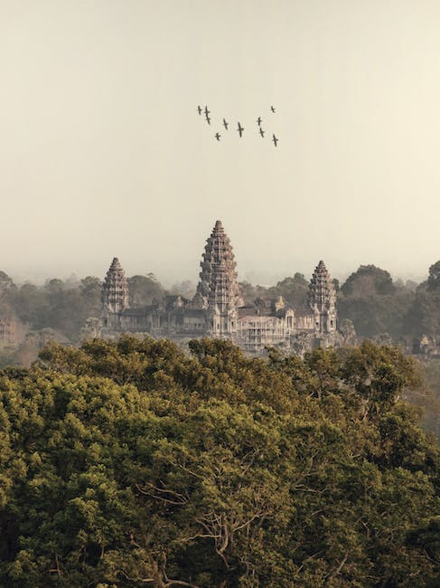
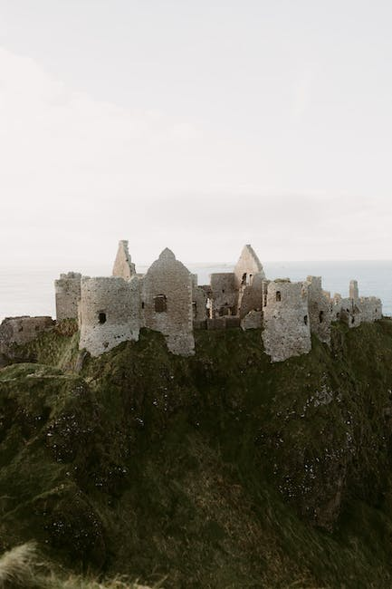

Running short of traveling ideas ? We have the solution!
Input
Output

Slide 3

Today’s journey
01
02
03
Prepare our lugage
Get our VISA
Travel
Data Collection
Data Cleaning
Exporting to MySQL
Data Exploratory Analysis with SQL and Python
Machine Learning
Live Demo

Slide 4
01
Preparing our lugage
“We are building our dataset to train the model. It needs to be clean and consistent.”

Slide 5
From Data Collection to MySQL database export
CHOOSE YOUR LUGAGE SIZE
Data Collection using Pexels API
DOUBLE-CHECK
Data Cleaning
LOCK IT
Exporting 4 entities/tables in to MySQL database

Slide 6
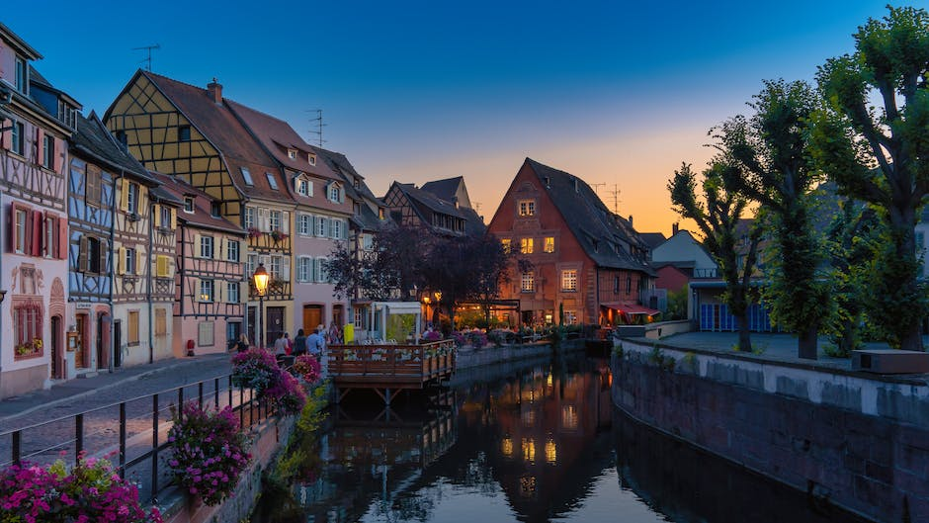
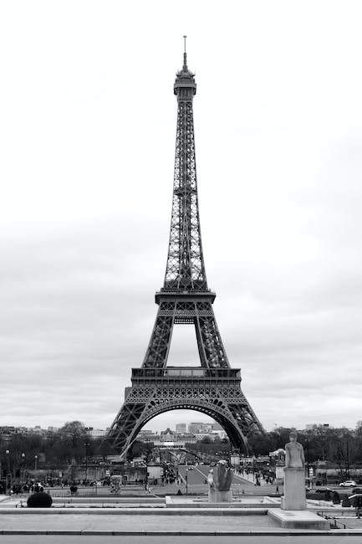
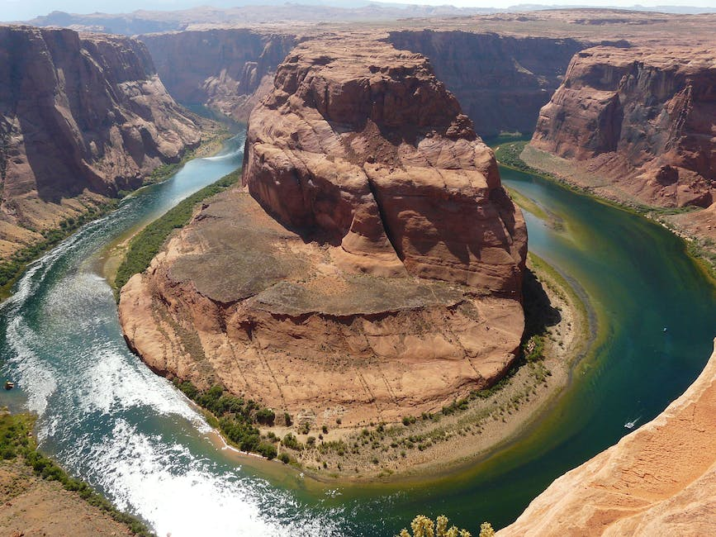
STEP 1: Data Collection (1/2)
I decided to use Pexels API to build the foundations of my datase. Pexels is a website that offers a vast collection of free-high quality photos, videos and illustrations.
I chose this API for 2 main reasons:
Convenience: it enables up to 200 requests per hour enabling me to do some “tests and trials” without being restricted and having to wait another day to pull more data.
Inspiring: since, I’m working on image recognition applied to Travel industry, I wanted to find high-quality and inspiring pictures.

Slide 7
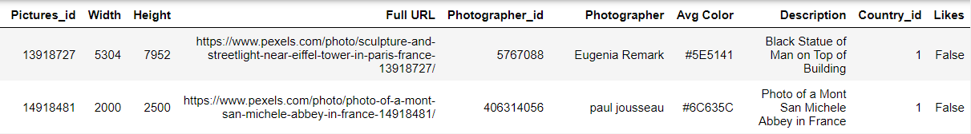
STEP 1: Data Collection (2/2)
Started with a list of most visited countries in the world (~50 counties).
Requested Pexels API to get pictures’ data (80 pictures per country and informative data) and querying with “France travels”, “Spain travels” etc. (iterating through my previous list). I used time.sleep(3) between each iteration of the loop to avoid ban.
Obtained an aggregated JSON files (list of dictionnaries, each picture is a dictionnary) and transformed it into the dataframe below (shape: 3920x10):

Slide 8
STEP 2: Data Cleaning
Check for null values but I did not have any.
Since I selected the top 80 pictures (top search results) per country, I could have some duplicated pictures. I decided to remove them using drop_duplicates on Pictures
Anticipating some NLP work later, I decided to standardize all columns containing string by removing special characters and transforming into lower case.
Results: our lugage is less heavy (-238 rows) and “description” and “Photographer” columns are clean.

Slide 9
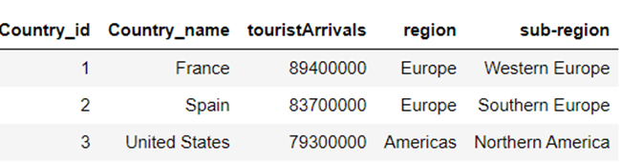
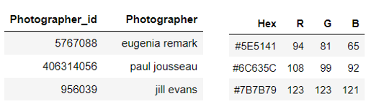

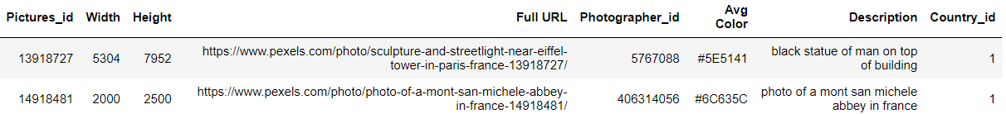
STEP 3: Exporting 4 entities/tables into MySQL (1/2)
After breaking up my main dataframe, I got 4 entities to export in MySQL database:
1. Countries Mapping (shape: 49x5):
3. Photographers Mapping (shape: 1515x2) and
4. Colors Mapping (3618x4):
2. API data (shape: 3682x8):

Slide 10
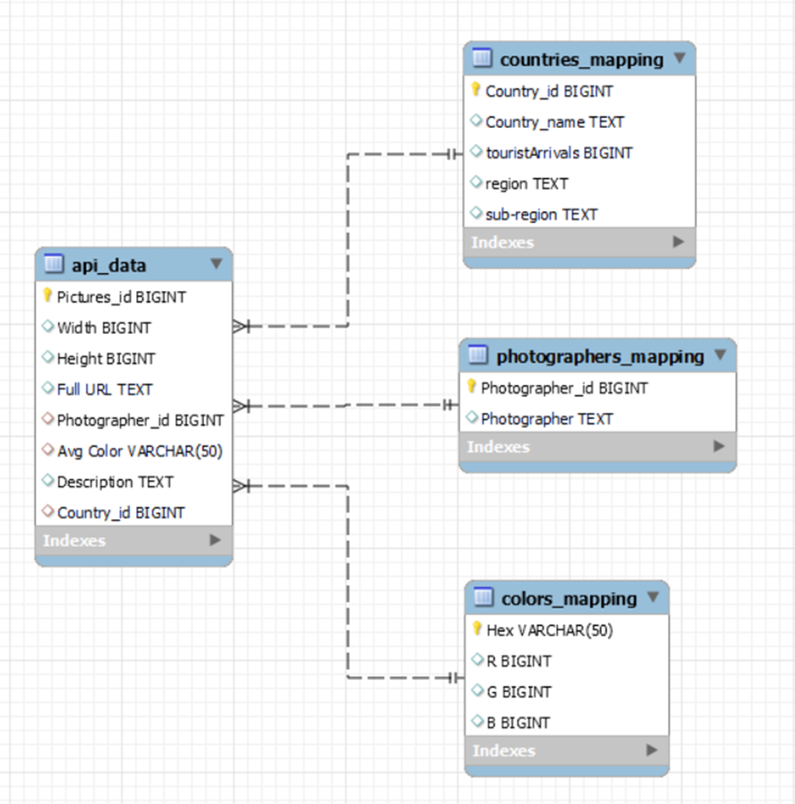

STEP 3: Exporting 4 entities/tables into MySQL (2/2)
After setting Primary/Foreign keys, below is my VISA (Entity Relationship Diagram):

Slide 11
02
Getting our VISA
Thanks to SQL and Python, we will begin our Data Exploratory Journey

Slide 12
Generate Insights with SQL and Python Data Analysis capabilities
Photographers and pictures breakdown
Who are they? How do they contribute?
Pictures’ colors
Pictures’ dimension
Any dominant colors?
Are they small, medium large? Any sucessful or preferred format?
Natural Language Processing
Most frequent words used in pictures’ description per country or region

Slide 13
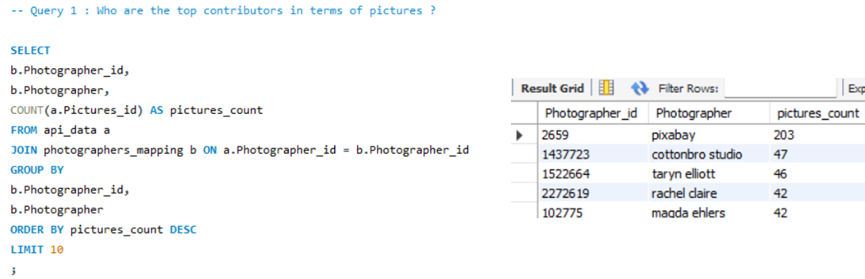
Insight 1: Photographers and pictures breakdown (1/2)
Questions: Who are the top photographers in terms of pictures’ contribution? What is the split between those who published only one picture and those who published 2+? And finally, are they “specialized” in one country or do they tend to publish pictures from several countries?
We can see that pictures could come from several sources such as existing websites (ex: pixabay), professional studio or individuals.

Slide 14
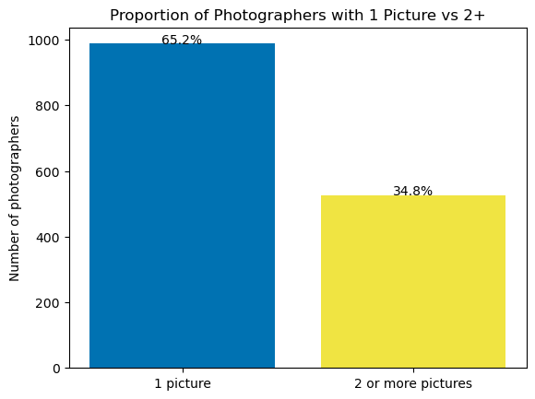
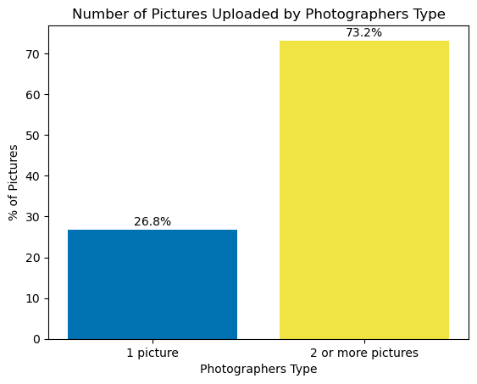
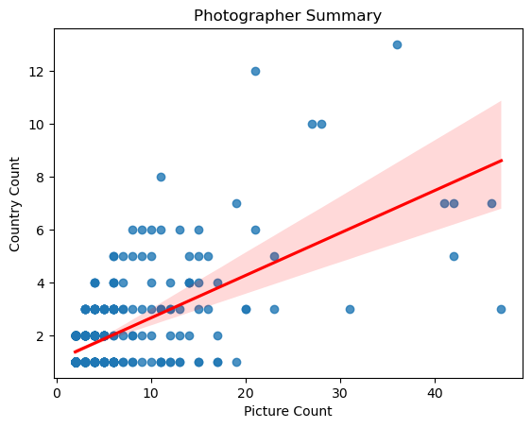
Insight 1: Photographers and pictures breakdown (2/2)
Deep dive and Data Visualization with Python:
Learnings: In our sample, most of the photographers published only one picture. But more than 7 out of 10 of the pictures are published by photographers who published at least 2 pictures. These photographers tend to propose diverse content (covering more than one country).

Slide 15
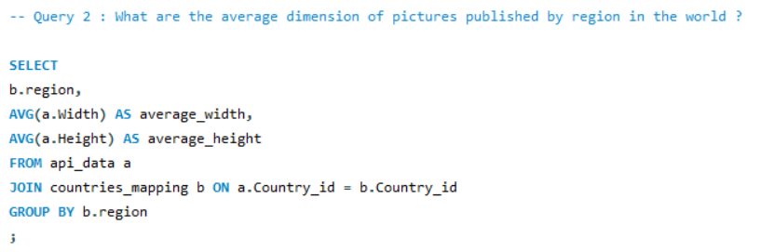
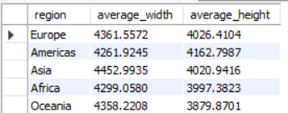
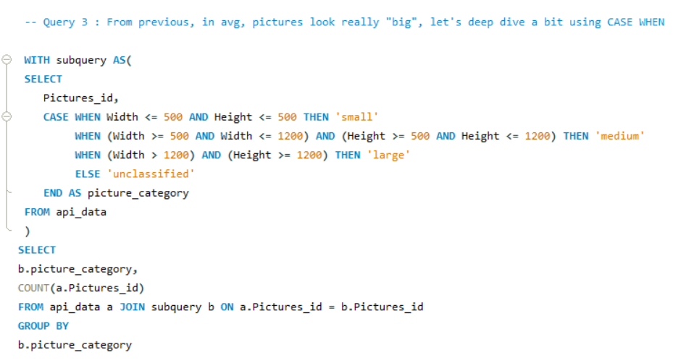
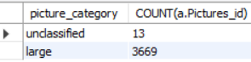
Insight 2: Pictures’ dimension (1/4)
Questions: Do photographers’ upload small, medium or large pictures? Do they have any preferences for landscape or portrait orientation? Let’s ask SQL again!

Slide 16
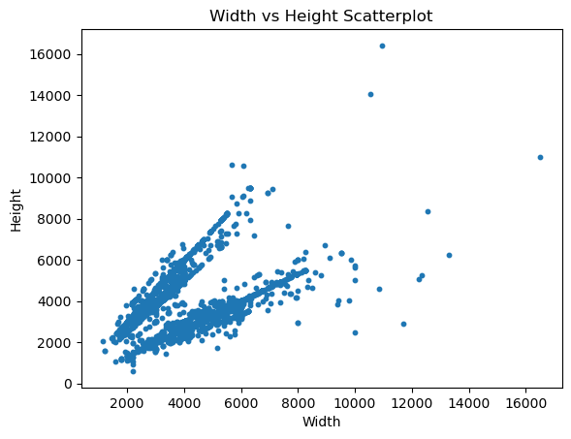
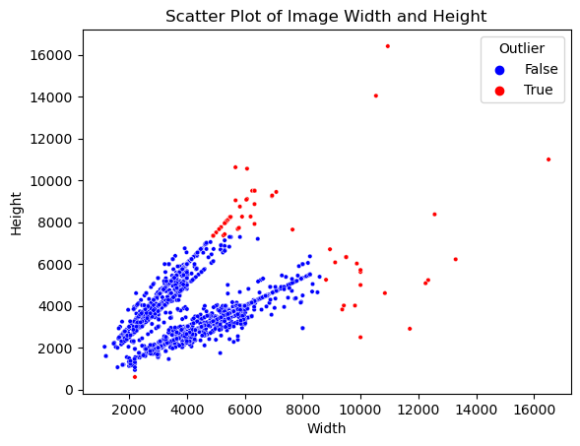
Insight 2: Pictures’ dimension (2/4)
Deep dive and Data Visualization with Python:
Learnings: Scatterplots above confirm our assumption that our dataset mostly contains large pictures (>1200 pixels for width and height). Note: while we don’t exclude outliers in our project, it’s worth mentioning that applying IQR method on both columns, we would have excluded red data points being pictures with too high or low width/height.

Slide 17
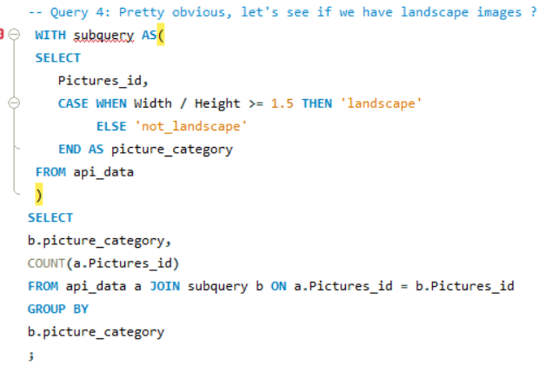
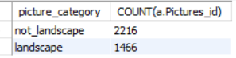
Insight 2: Pictures’ dimension (3/4)
Question: Having a closer look on our previous charts, it looks like we have a “two axis” separation in our data points distribution. Could it be linked to aspect ratio (defined as width/height) meaning we have landscape and portrait orientation as predominant pictures’ format?
It looks like that we had a good intuition on this “two axis” separation. It’s linked to the landscape/portrait orientation (knowing that portrait orientation is defined as aspect ratio >= 1.5).

Slide 18
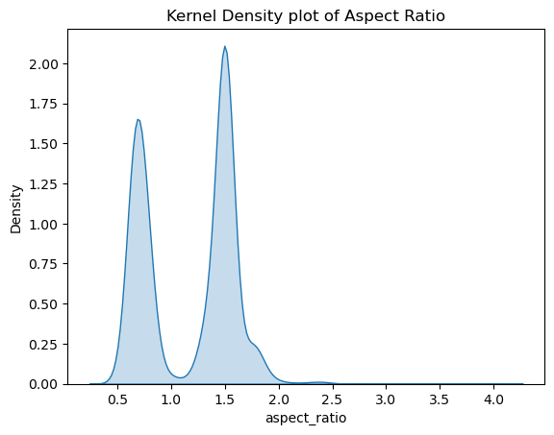
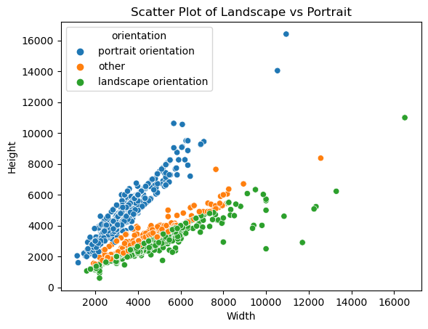
Insight 2: Pictures’ dimension (4/4)
Deep dive and Data Visualization with Python:
Learnings: In this part, we learn that Pexels does comply with its promise of offering free high-quality pictures since most of the pictures of our sample are considered as large. Also, we can see that the most popular orientations in photography (portrait and landscape) are represented in our dataset.

Slide 19
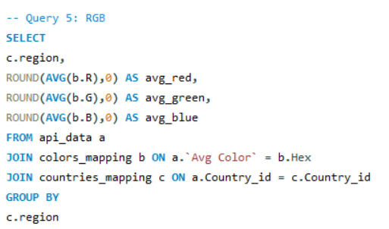
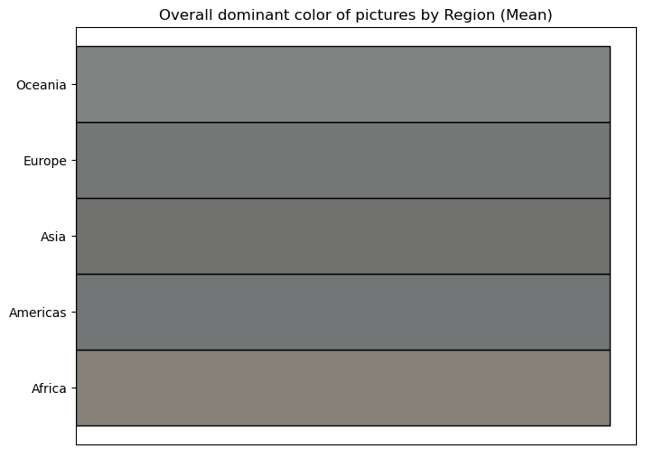
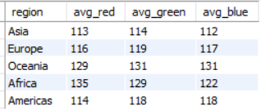
Insight 3: Pictures’ colors (1/2)
Question: Remember about our Hex column (representing the dominant color of the picture according to Pexels API) that I also converted into RGB (Red, Green, Blue) components? Let’s have a further look into this with SQL!
In the query above, I retrieved the average component (RGB) per region. The idea behind is to “plot” these colors so that we can visually see if the colors’ tone are different across regions in the world. But it seems there is an issue using average/mean.

Slide 20
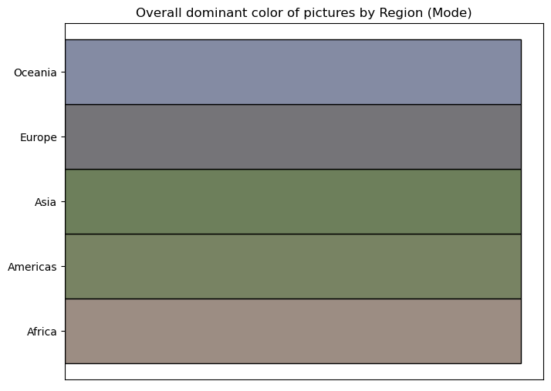
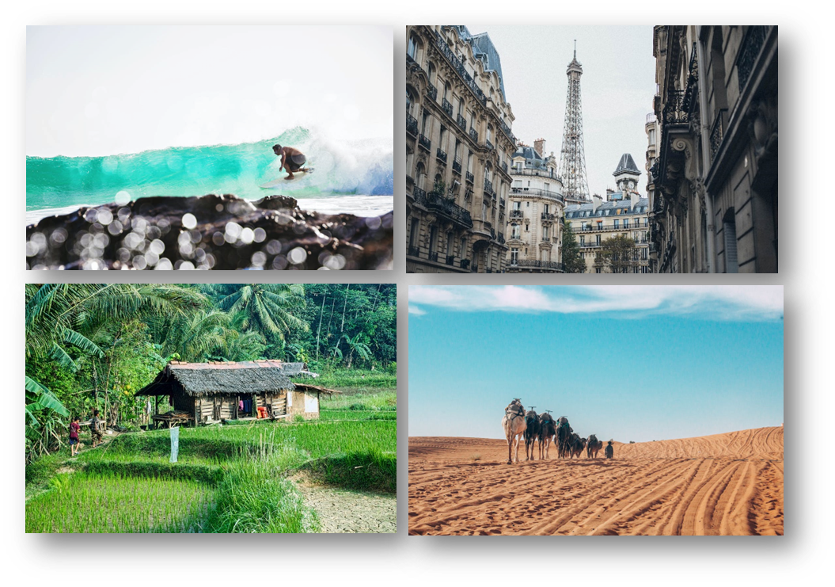
Insight 3: Pictures’ colors (2/2)
Deep dive and Data Visualization with Python:
Learnings: In this part, we learnt that the mode (on RGB) was the most effective way to visualize the most frequent dominant colors’ tone per region. This simple but powerful insights gave us confidence in Pexels API data’s reliability.

Slide 21
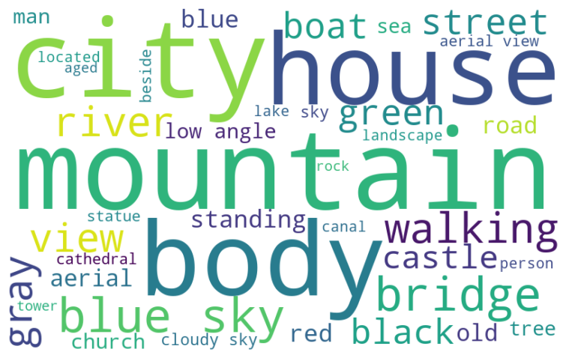
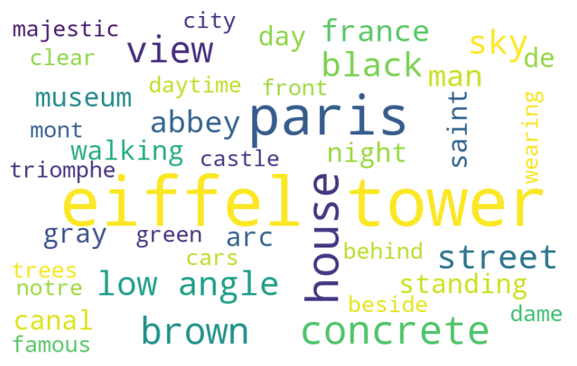
Insight 4: Pictures’ description (NLP)
Question: What are the most frequent words used in pictures’ description? Does it differ from one country to another?
Learnings: Let’s start with Europe, as you can see above, “city, house, mountain” are among the most frequent words along with “walking, castle or bridge” depicting modern infrastructures and historical vestiges! At country level, it’s amazing to capture more specific words such as “Eiffel tower, notre dame, abbey” or “majestic” depicting the magic of the City of Lights.

Slide 22
Insights Summary
Most of the photographers only published one picture but those who published at least 2 accounted for more than 73% of total pictures count and tend to cover several countries (diversified)
By far, photographers tend to prefer uploading large pictures (with average width and height above 4,000 pixels) ensuring the best quality for users.
The colors that we plotted (with RGB components mode) were in line with our expectations and strengthened the confidence we had on Pexels API data’s reliability.
NLP on pictures’ description enabled us to capture the most frequent words used in our sample such as “mountain, blue sky or city” as well as very specific words at country level such as “notre dame, Eiffel tower or majectic” for France.

Slide 23
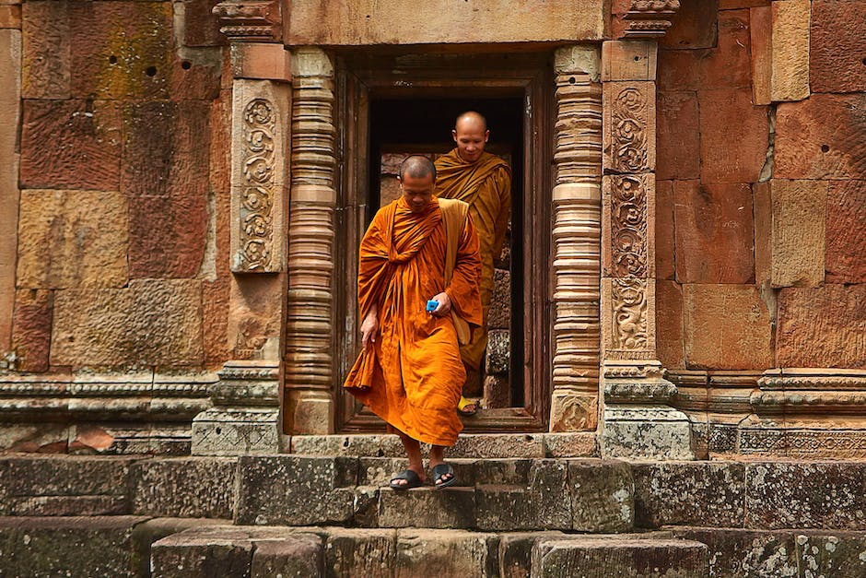
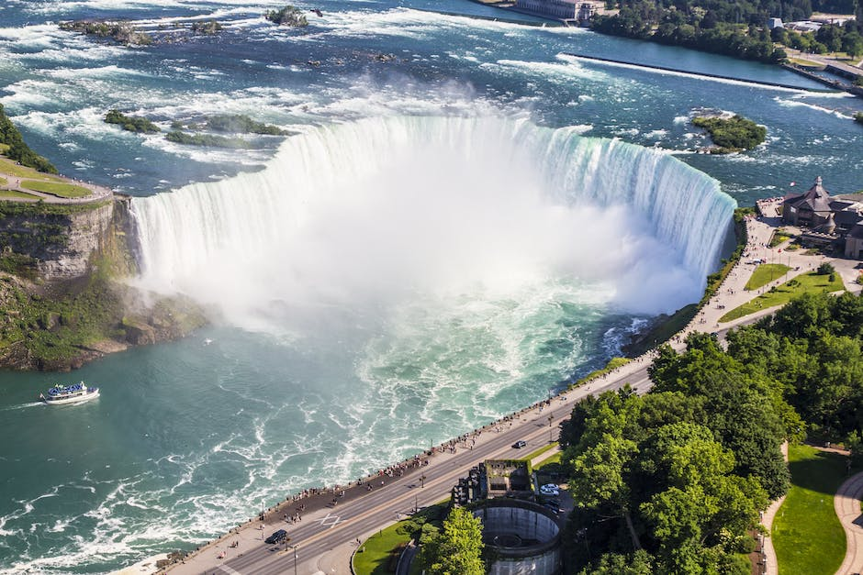
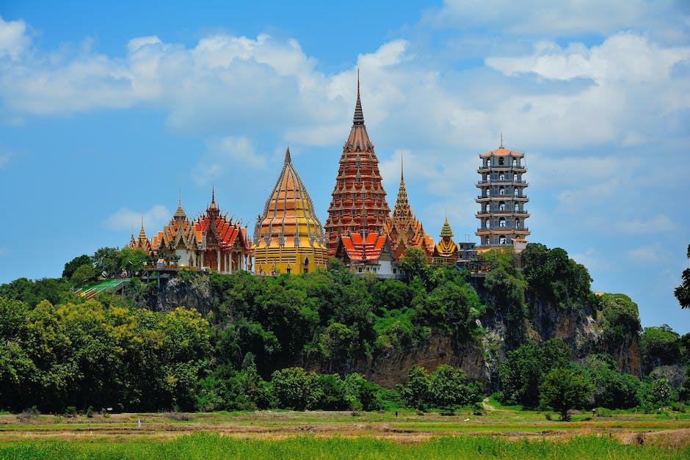
03
Travel
Fun part! Machine Learning and Live Demo.

Slide 24

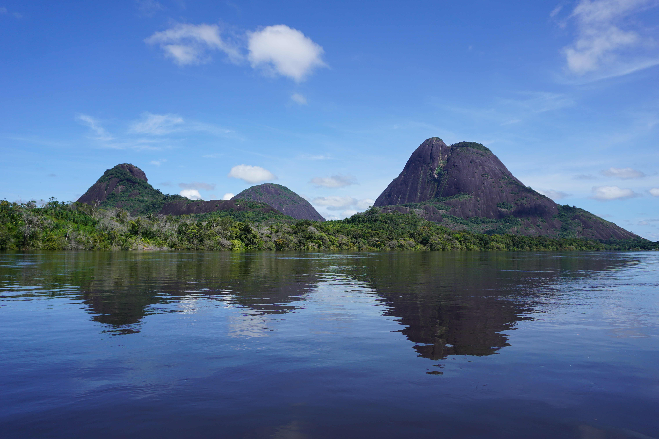
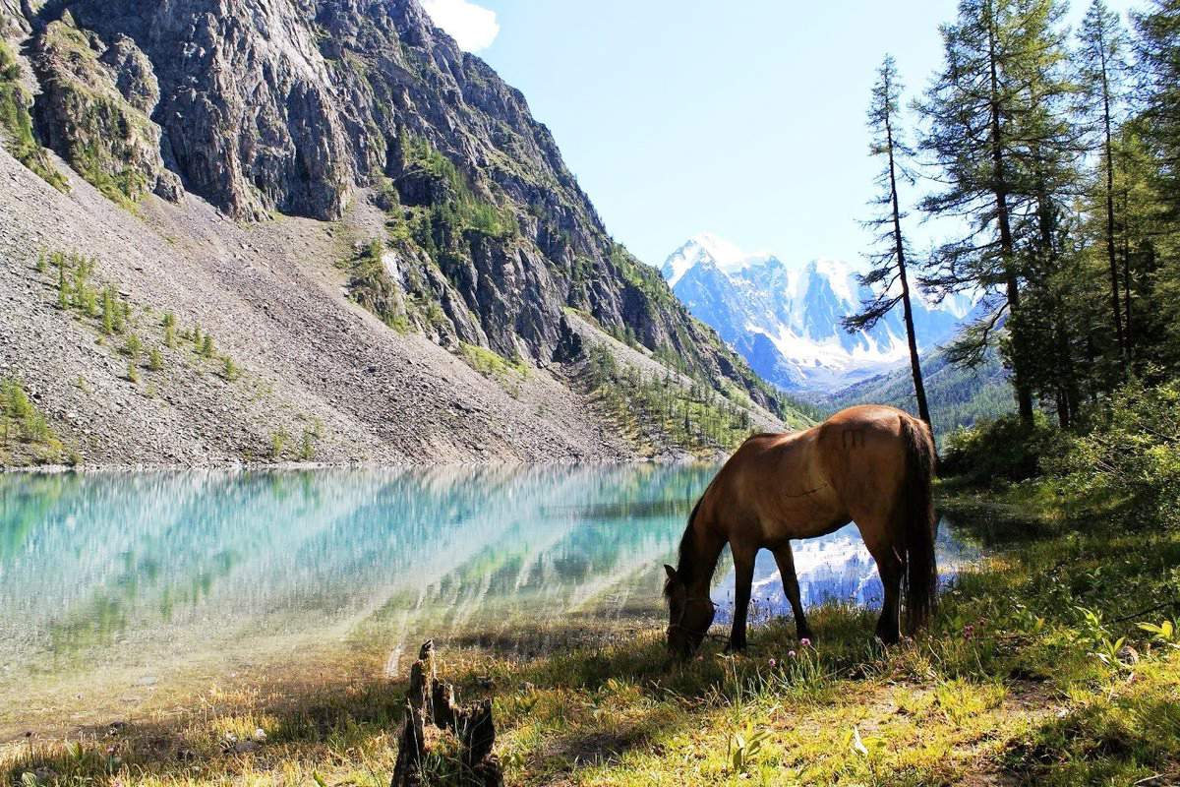
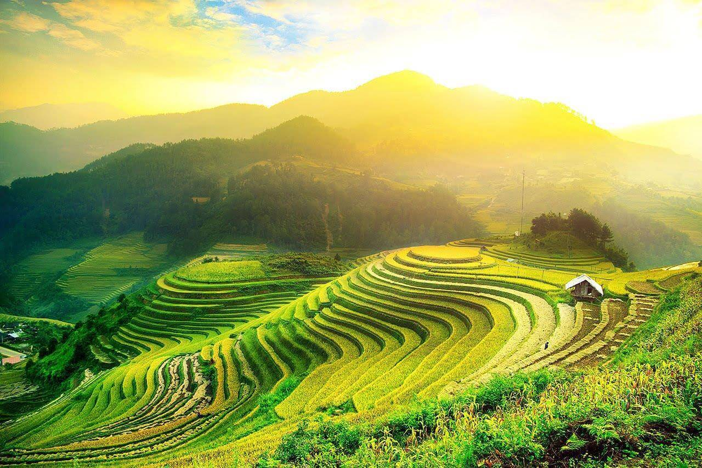
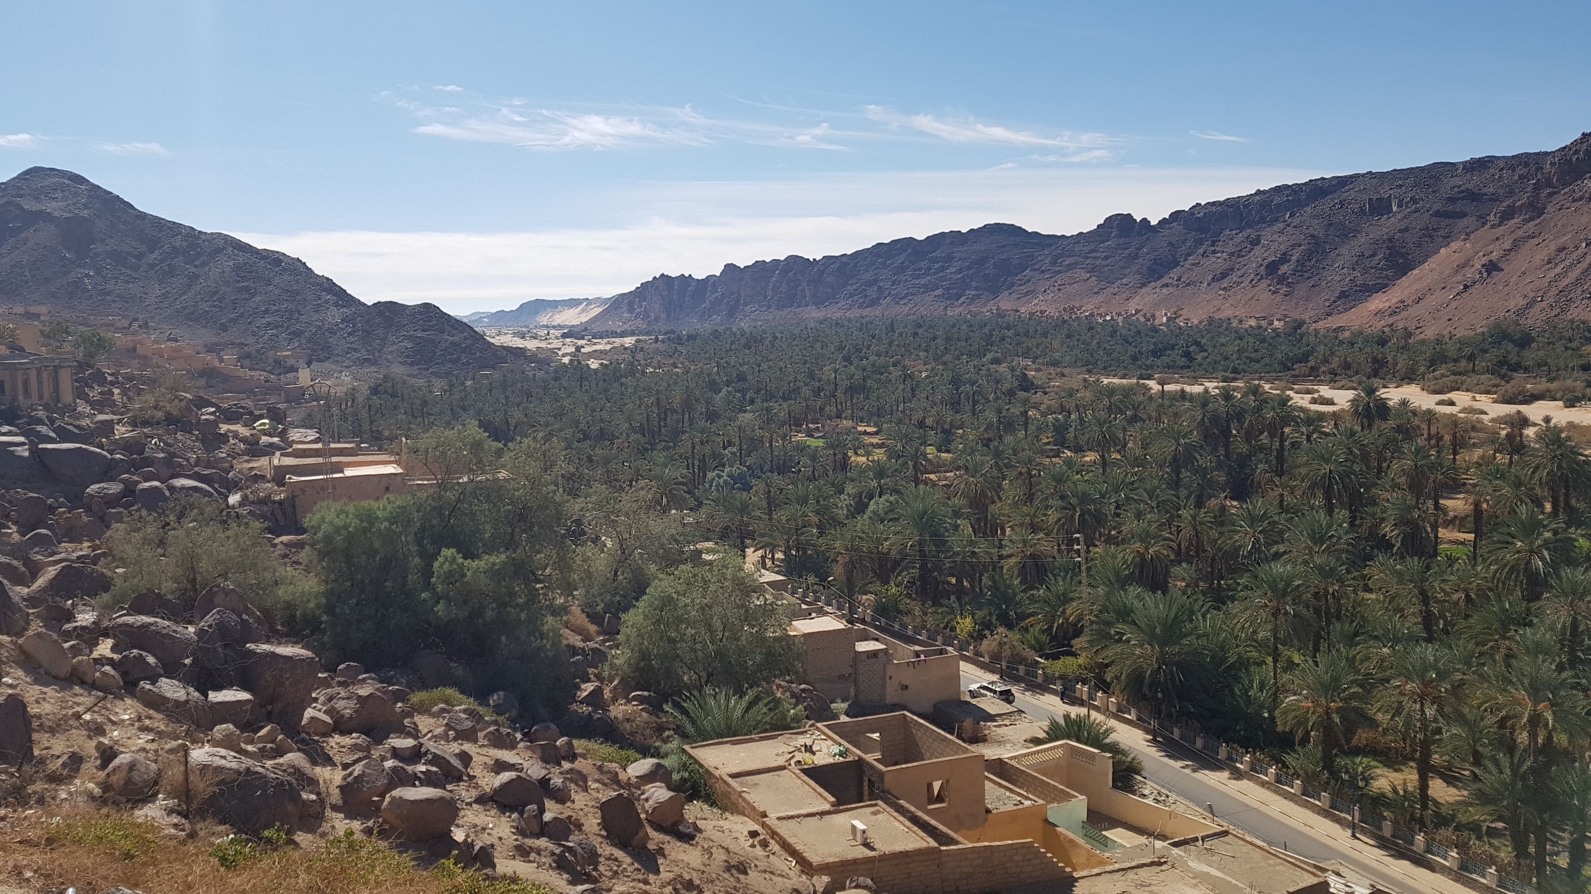
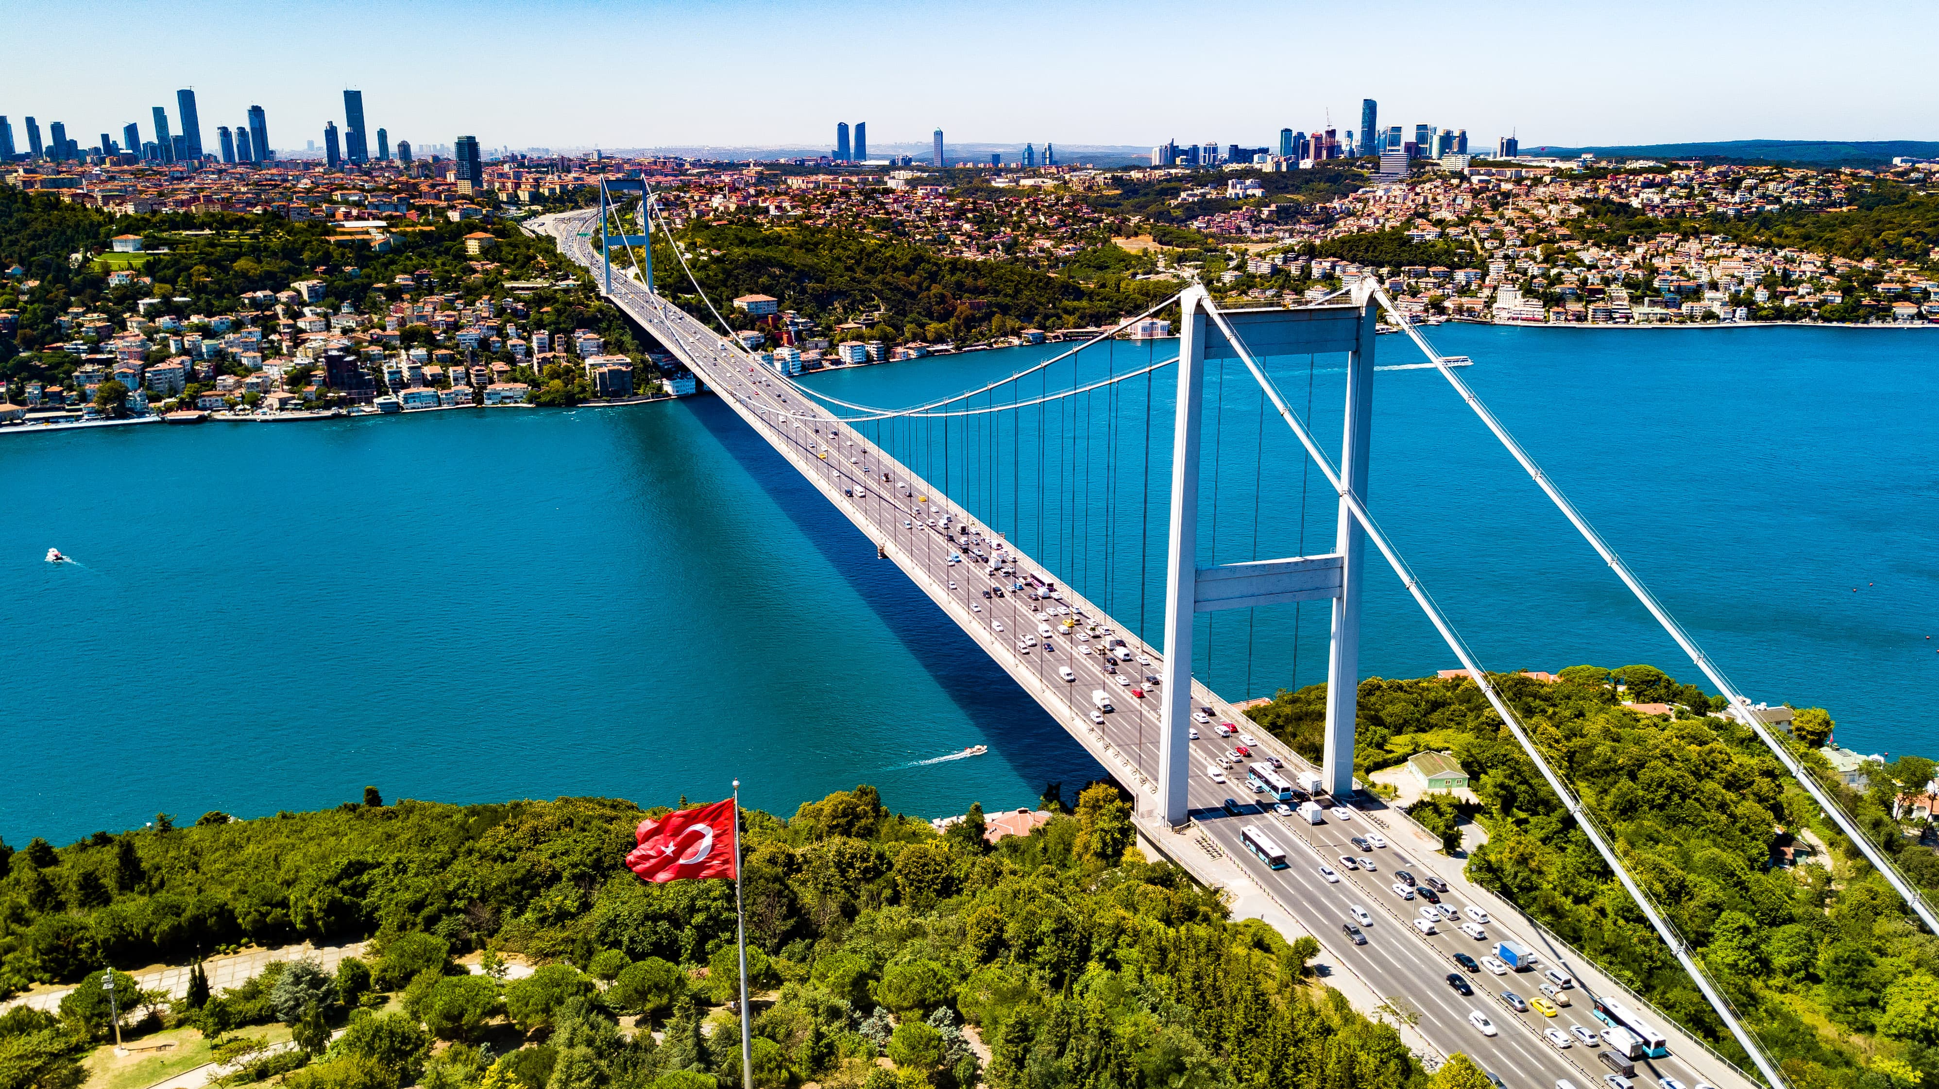
What will the model return? Taking students’ pictures as test data!
Angela
Katerina
Yen
Kaci
Berkay

Slide 25
Behind the “machine learning” scenes (2/2)
Remember that I got the URLs of more than 3,600 pictures? I first used a python script to iterate through all of the URLs and save all the pictures in a local folder.
Since my goal is to do K-means clustering (unsupervised learning algorithm) to identify groups in data without prior any knowledge or labels, I need to get features per picture.
To achieve this goal, I used VGG16 as a pre-trained deep learning model to extract features from my images. VGG16 is a convolutional neural network (CNN) model used for image classification. The last layer of VGG16 produces a feature vector of length 4096 for each input image.
To put in simple words, the input image (224x224x3) goes through different layers that extract features (edges, corners, textures, shapes…). At the end, we obtain per picture, a 4096-dimensional vector which represents a compressed version of the image (capturing the most important features for classification).

Slide 26
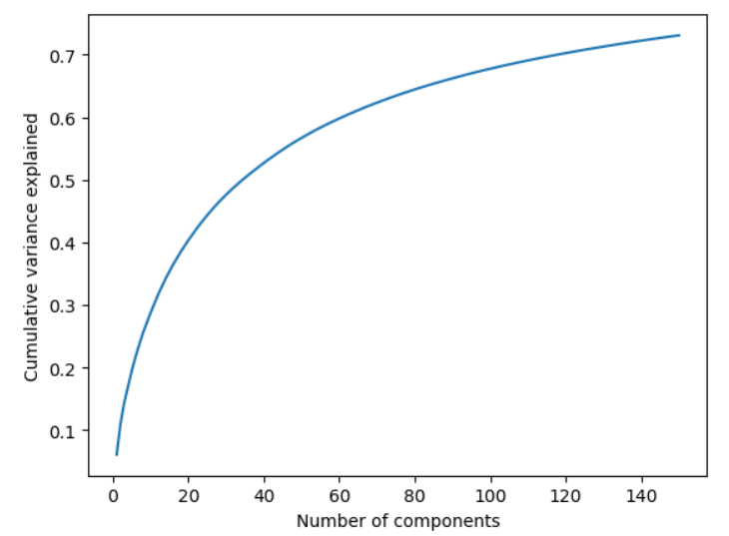
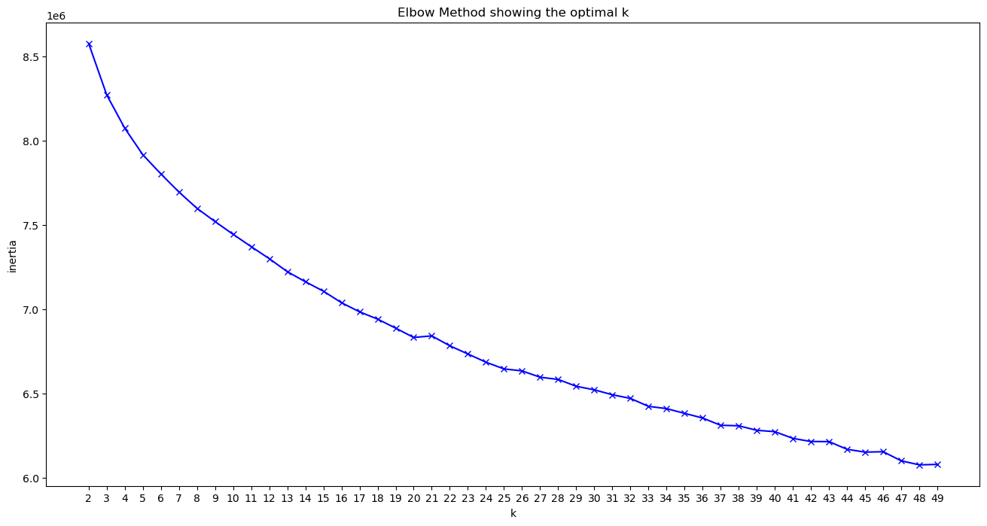
Behind the “machine learning” scenes (2/2)
Features scaling using StandardScaler
Saving scaler as pickle
Principal Component Analysis to reduce dimensions from 4096 to 120 features
K-means clustering (20
clusters in total) leveraving elbow chart to make a decision
N_components =120 to explain 70% of variance

Slide 27
Live Demo!
I have built 2 possible scenarios:
Scenario 1:
The user plays with existing dataset (clustered).
The user inputs a Region/Country and chooses between 5 random pictures from this country.
The machine recommends 5 random similar pictures (from the same cluster) but not in the same country to help decision-making/brainstorming.
Scenario 2:
The user submits new pictures to the model (not in the dataset, test data).
The model extracts the pictures’ features, scaled the features, performed PCA and predict with K-means (all parameters saved before as pickles).
The machine recommends 5 random similar pictures (from the same cluster) but not in the same country to help decision-making/brainstorming.

Slide 28
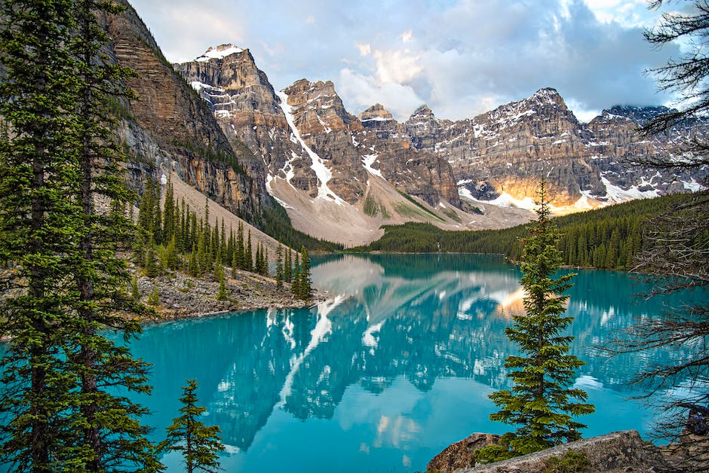
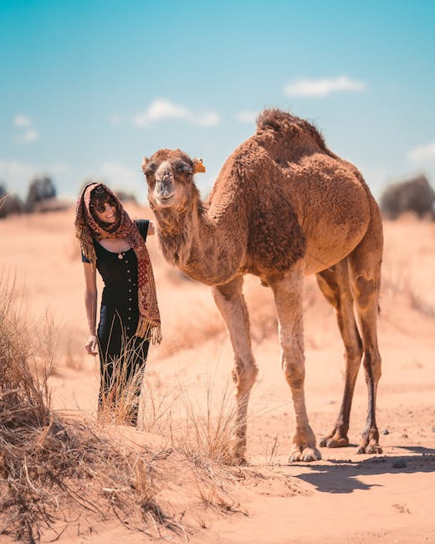
Happy Pairs!
Input
Input
Output
Output

Slide 29
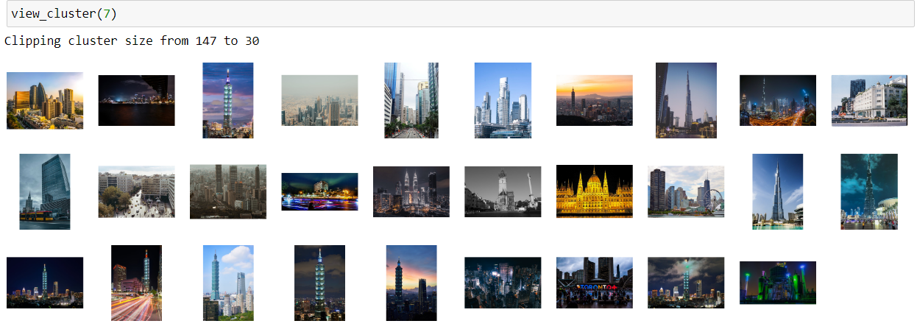
Examples of Clusters (1/2) :
Buildings:

Slide 30
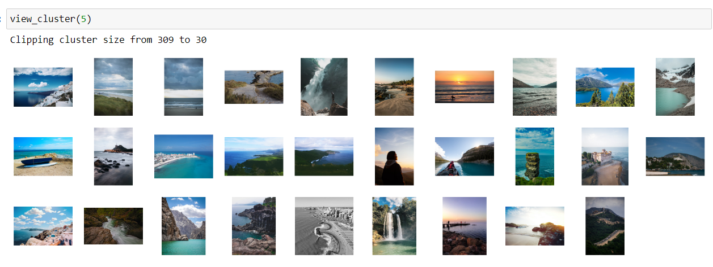
Examples of Clusters (2/2) :
Sea:

Slide 31
Next steps/Other Ideas
Traveling is always short, and when an adventure comes to an end, we often think about the next steps or what we could have done differently:
Exploring features extraction without VGG16 with other techniques such as: color histogram (based on the distribution of colors in the image, used a feature vector) and/or bag of words (focusing more on similar shapes’ frequency).
Exploiting more the description column as “search bar”.
Continue with supervised learning: use the outputs of clustering to label similar pictures in order to build classifiers. So that the users can search by labels.
Implement streamlit user interface.

Slide 32
THANK YOU FOR TRAVELLING WITH US!
LINKEDIN
Kévin THAI
+33 6 45 87 41 88
MAIL
Kevin.thai@edhec.com
GITHUB
kevinthai-ironhack

